Slide 1

CoderDojo
Scratch Beginners
Code and notes by permission Michael Madden, 2012

Slide 2
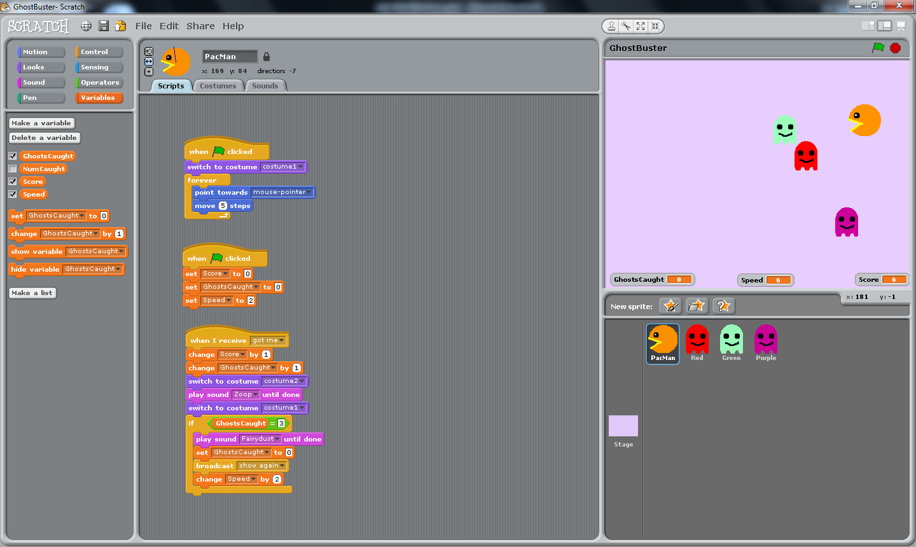
Today's Ninja Challenge: Create a GhostBuster Game Like This

Slide 3
Today's Big Ideas
Designing your game
Loops &
Decisions
Variables
Ideas from last time …

Slide 4

How to Get Started
Plan the Design
Create First Character
Think first!
Design it: appearance & behaviours
Test It
Any bugs? (Not working as expected)
Extend It
More Characters, More Behaviours, More Testing!
Start simple: add more later
Write script (Code) to control its behaviours
Debug and Improve
Reminder from Week 1

Slide 5
Steps to Make the Game
Make the Bat sprite, write & test code to control it
Make the Ball sprite, write code to make it move & animate
Add an End Line and a Lives variable; Lose a live when ball hits line
Make a Brick sprite, write its code; Test it works then duplicate it
Your game will have slightly different steps.
Get one part working before moving on!

Slide 6
Steps To Make This Game
Create your Ghost Catcher: appearance?
Code to control it with mouse
Create first Ghost: appearance & code
Duplicate it when it is working
Make things happen when a Ghost is caught
Add variable for Score
Optional: New level when all caught
Change the Stage: Plain coloured background?

Slide 7
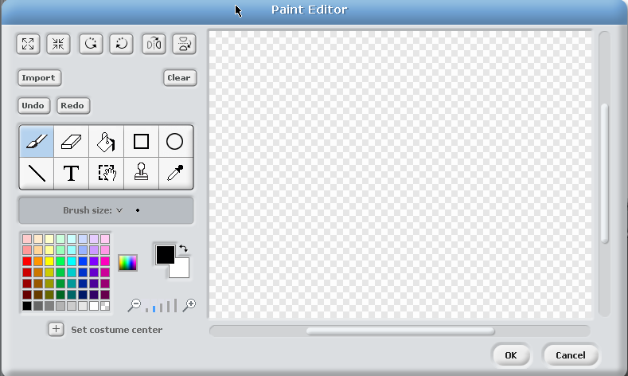
Paint Editor in Scratch
Paintbrush
Eraser
Fill tool
Rectangle
Ellipse
Eyedropper
Stamp
Select
Text
Line

Slide 8
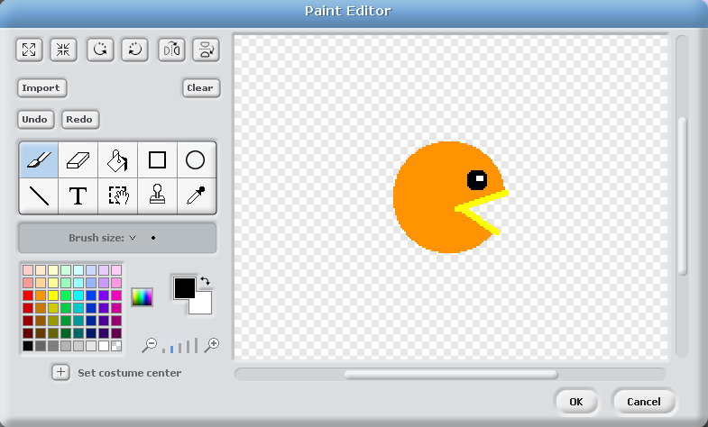
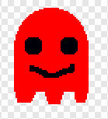
Design PacMan and a Ghost
Circles: head & eyes
Fill with "blank"
Circles, Rectangle & Paintbrush
Lines for mouth
TIP: Use distinctive colour (e.g. yellow) at front/mouth:
will use this when detecting if ghost is eaten

Slide 9
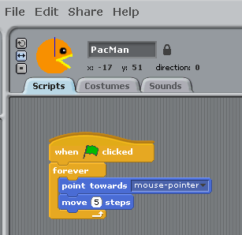
Make PacMan Follow the Mouse
Buttons: Rotate any direction
Face left/right
Don't rotate

Slide 10
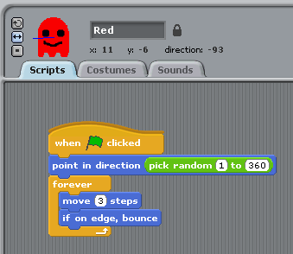
Make Ghost Move Around
What is significance of 1-360?
TIP: Get one ghost working fully – you can duplicate it later.
Right-click on a sprite to duplicate it.

Slide 11





Loops and Decisions
Key programming concepts
Loop:
Repeat code multiple times
Decision:
Decide whether or not to do something

Slide 12
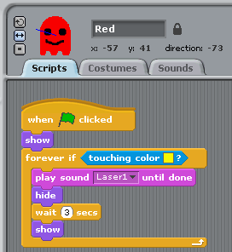
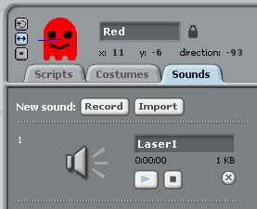
When PacMan Gets Ghost …
How we detect PacMan: colour of its mouth
Show at start.
Hide when eaten.
Wait & show again.
Switch to Sounds tab & import sound

Slide 13
Duplicate Ghost, Make Each One Look Different

Slide 14

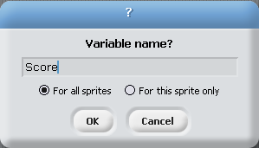
Variables
To keep score, need a Variable:
A key programming concept
Stores a Value (number/text data): this can vary
Has a Name – this is fixed: use this in the code to compare/change values

Slide 15
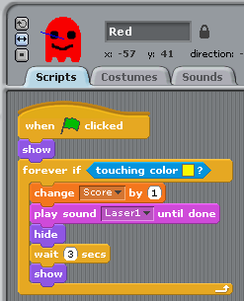
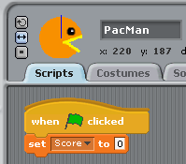
Variable to Keep Score
Variables can be:
Global (for all sprites): what we will use
Local (one sprite only)
To do:
Make variable
Set it to 0 at start
Add 1 each time a ghost is killed
1
3
2
Add this to every ghost

Slide 16
If You Want to Do More …
Add Levels:
When you have caught 6 ghosts, make the ghosts go faster
You will need:
Variable for Speed, initially 2
Variable for GhostsCaught
Code: when GhostsCaught = 6, set it back to 0 and increase Speed by 2

Slide 17


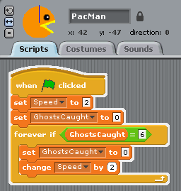
If You Want to Do More …
Make a variable Speed
Set it to 2 at start
Change ghosts to move at that speed
Make variable GhostsCaught
When ghost is caught, Change by GhostsCaught by 1 (beside where you change Score by 1)
Add code to PacMan:
Set GhostsCaught to 0 at start
If GhostsCaught is 6
Change back to 0
Increase Speed by 2

Slide 18
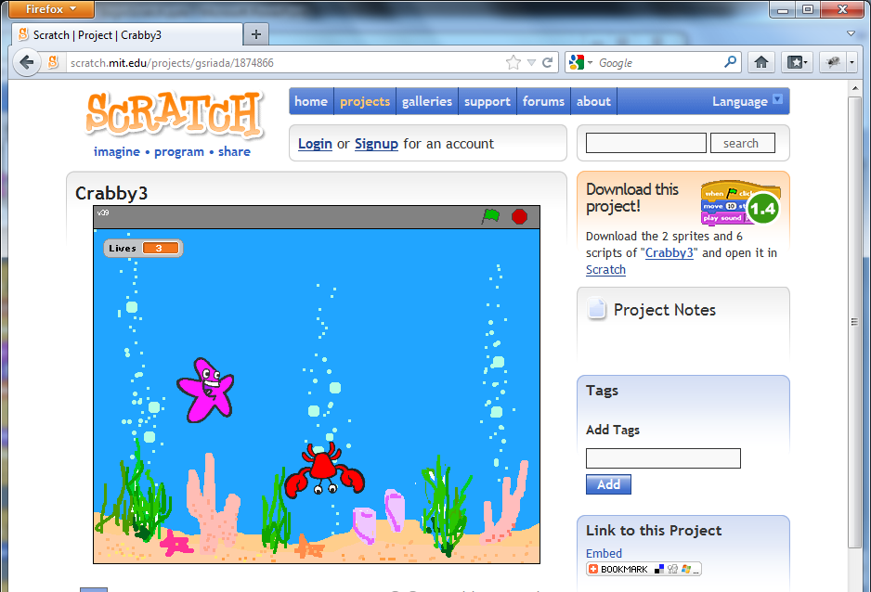
At the End …
Upload your project to the Scratch Website user: emcdojo password: cork123
Access it
from home
Improve it
Show your
friends!

